Slide 1
Probabilistic Programming
Frank Wood
fwood@robots.ox.ac.uk
http://www.robots.ox.ac.uk/~fwood
MLSS 2014
April, 2014 Reykjavik
TA : Yura Perov
perov@robots.ox.ac.uk

Slide 2



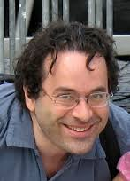

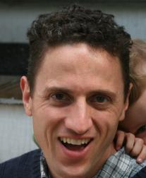
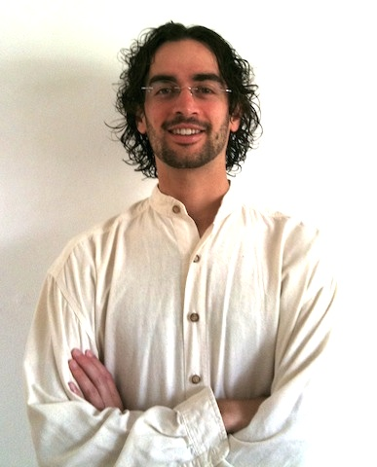
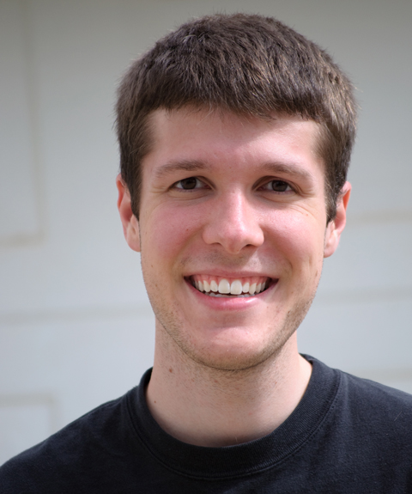

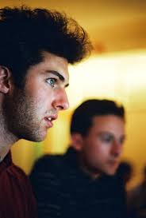
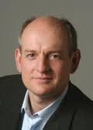
Other People Who Could Give This Tutorial
van de Meent
Paige
Mansinghka
Pfeffer
Perov
Wingate
Goodman
Ritchie
Stuhlmüller
Roy
Russell
And others, with apologies …

Slide 3
What is Probabilistic Programming?

Slide 4
Overarching Goals
Accelerate iteration over models
Inference is automatic
Writing generative code is easier than deriving model inverses
Lower technical barrier of entry to development of new models
Accelerate iteration over inference procedures
Computer language is an abstraction barrier
Inference procedures can be tested against a library of models
Inference procedures become “compiler optimizations”
Enable development of more expressive models
Probabilistic programs can express a superset of graphical models
Modern machine learning models are tens of lines of code
Notes:
Accelerate iteration over models
Code is easier to read and write than math
Lower technical barrier of entry to development of new models
Accelerate iteration over inference procedures
Computer language is an abstraction barrier
Inference procedures can be tested against a library of models
Inference procedures become “compiler optimizations”
Enable development of more expressive models
Probabilistic programs can express a superset of graphical models
Modern machine learning models are tens of lines of code

Slide 5
Tutorial Outline
Programming
Understanding
Practicum / Bayesian Nonparametrics

Slide 6
Programming
Systems
Problem Template
Syntax
Semantics
Simple examples
Interpreting output
Limitations
Demonstration
Exercises

Slide 7
Systems
Application driven
BUGS [Spiegelhalter et al, 1996]
STAN [Stan Dev. Team, 2013]
Infer.NET [Minka, Winn et al, 2010]
Other
IBAL/Figaro [Pfeffer, 2001/2009]
BLOG [Milch et al, 2004]
Higher-order, Turing-complete
Church [Goodman, Mansinghka, et al, 2008/2012]
Random Database [Wingate, Stuhlmüller et al, 2011]
Anglican [W. et al, AISTATS, 2014]
Probabilistic-C [Paige, W., to appear @ICML, 2014]
Venture [Mansinghka, et al, arXiv, 2014]
And others, with apologies …

Slide 8


Anglican
Perov
van de Meent
Mansinghka
A “Church” of England “Venture”
http://www.robots.ox.ac.uk/~fwood/anglican/
Please report bugs to
https://bitbucket.org/fwood/anglican/issues
W., van de Meent, Mansinghka “A New Approach to Probabilistic Programming Inference” AISTATS 2014

Slide 9
Anglican
Applicability
Turing-complete, higher-order probabilistic research programming language
Supports accurate inference in programs that make use of complex control flow, including stochastic recursion, and primitives from Bayesian nonparametric statistics
Actually useful now for small models!
Introduced Particle MCMC for prob. prog. inference
Theory suggests PMCMC, particularly particle Gibbs, has nice theoretical convergence properties *
Probabilistic programming violates most assumptions
Improved performance over a wide variety of programs anyway
Opens path to massive scalability
Very simple to implement
Requires simple machine layer abstraction
* Andrieu, Lee, and Vihola, Uniform Ergodicity of the Iterated Conditional SMC and Geometric Ergodicity of Particle Gibbs samplers, 2013

Slide 10
Next Step : Probabilistic-C
Paige
Paige and W. “A Compilation Target for Probabilistic Programming Languages.” ICML, 2014

Slide 11
Probabilistic-C = Compiled PMCMC ≈ 100× Speedup
Paige
HMM 10-states, 50 observations
CRP 10 observation mixture of 1-D Gaussian
Ritchie
Compiled MH - https://github.com/dritchie/probabilistic-js

Slide 12
Systems Research Path to Scalability
Paige
Time to produce 10,000 samples running probabilistic-C HMM code on multi-core EC2 instances with identical processor type while varying number of particles (bars). Both more cores and more particles eventually degrade performance suggesting the existence of system optimizations for high performance probabilistic programming inference.

Slide 13
Venture
Mansinghka
http://probcomp.csail.mit.edu/venture/
Programming Language and Platform
Interactive
Programmable Inference
Compositional language for custom inference strategies
Path to scalability
Efficient execution trace re-use
Details
Introduced “directive” syntax and semantics
Tight Python integration
Syntax inspired Anglican’s; semantics currently differ slightly
Mansinghka, Selsam, and Perov “Venture: a higher-order probabilistic programming platform with programmable inference” arXiv, 2014

Slide 14
Problem Template
Deterministic simulator exists as code
Parameter uncertainties exist
Varying parameters to simulator = stochastic simulator
What to do with observations?
Update estimates of parameters
Posterior predictions

Slide 15
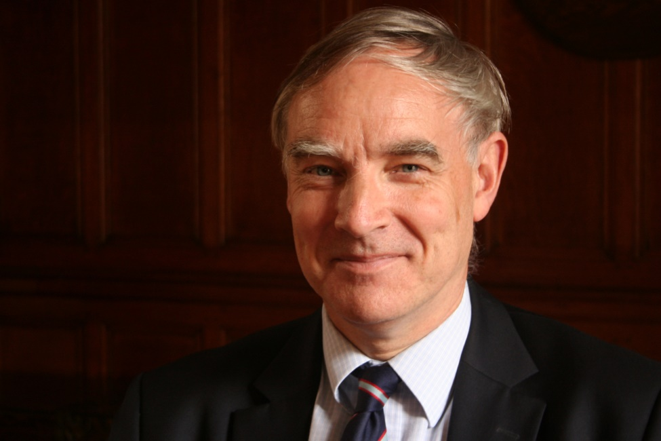
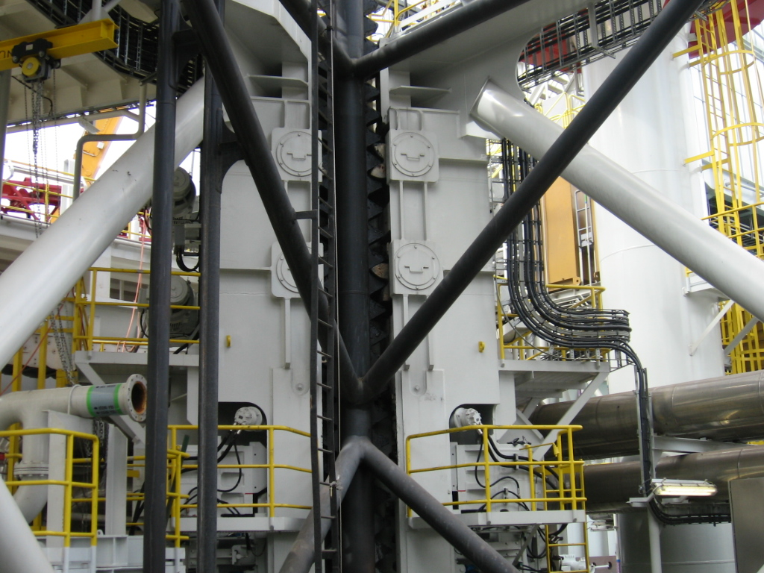
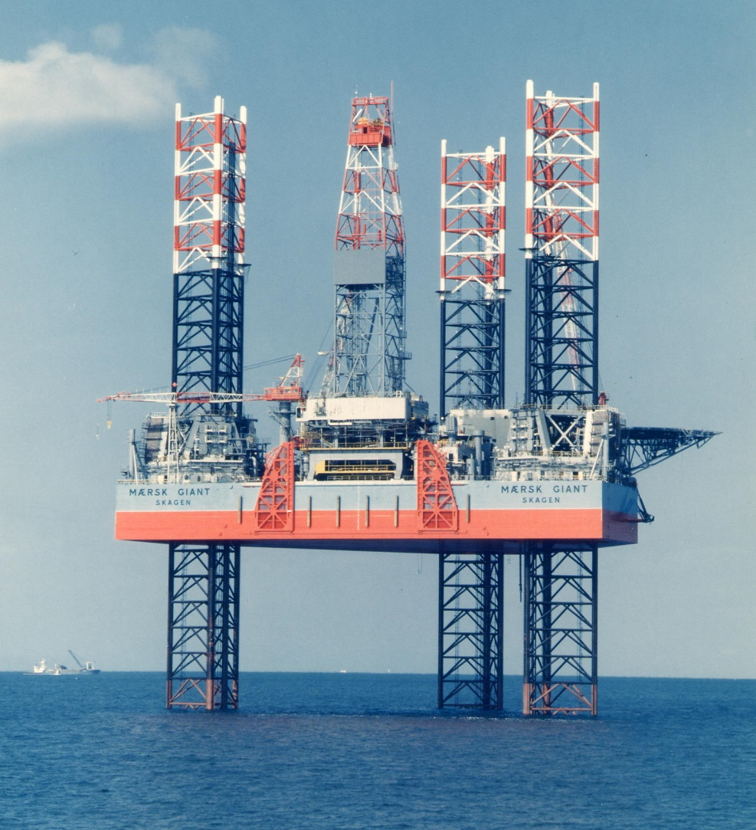
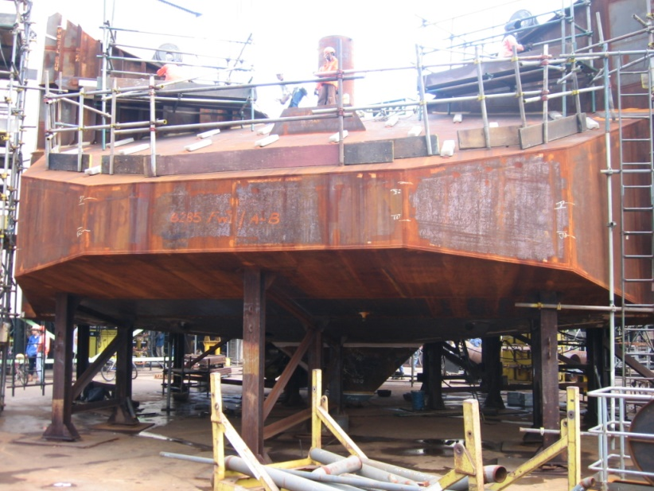
Example : Jack-Up Units
Houlsby
60m
Keppel FELS
Maersk
Keppel FELS
Slide from Houlsby

Slide 16
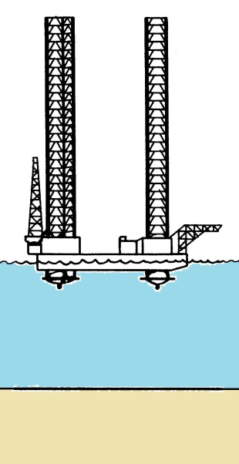
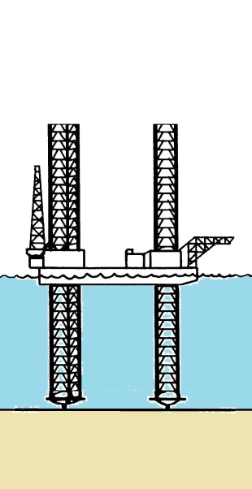



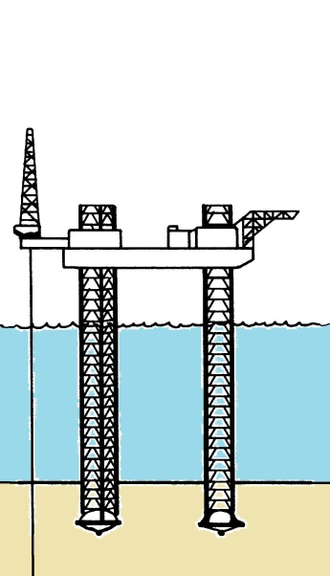
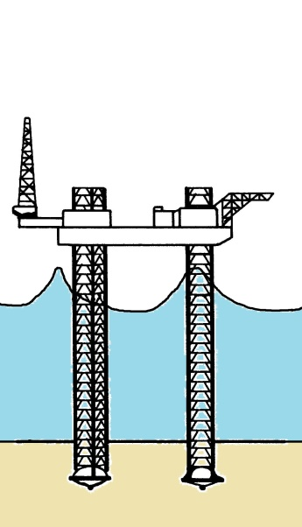
Jack-up operations
Float to site
Lower legs
Light ship load
Preload
Dump preload
Climb to air-gap and operate
Storm
sketches after Poulos (1988)
Slide from Houlsby

Slide 17
Spudcan Simulator + Probabilistic-C -> Inference
Deterministic simulation
~750 lines of C code
10-100’s of parameters
Black-box
Not differentiable
Stochastic simulation
+150 lines of C code
Priors on parameters
Automatic inference
+15 lines of Probabilistic-C
~1000 samples / second

Slide 18
Parameter Posterior vs. Expert

Slide 19
Inverse Graphics via Venture
Fits Template
Generative scene model as program
Deterministic simulator (renderer)
Automatic inversion
Mansinghka, Kulkarni, Perov, and Tenenbaum “Approximate Bayesian Image Interpretation using Generative Probabilistic Graphics Programs.” NIPS, 2013

Slide 20
Basic Probabilistic Programming Concepts
Procedures “sample”
Programs are generative models
Mixed deterministic and stochastic procedures
Not generally differentiable w.r.t. parameters
No factor graph correspondence in general
May have nondeterministic random variable cardinality

Slide 21
Writing Probabilistic Programs
Syntax
Directives
Expressions
Semantics
Via examples

Slide 22
Syntax : Directives
[assume symbol expr]
[observe expr value]
[predict expr]
[observe-csv url csv-expr csv-value]
[import url]
http://www.robots.ox.ac.uk/~fwood/anglican/language/

Slide 23
Syntax : Expressions (Lisp/Scheme)
expr = literal | symbol | list
literal = boolean | long | rational | double | string | nil
list = () | (keyword & exprs) | (proc & exprs)
keyword = quote | define | lambda | if | cond | let | begin
http://www.robots.ox.ac.uk/~fwood/anglican/language/

Slide 24
Keyword : quote
'expr <=> (quote expr) => expr
A quoted expression. Yields an unevaluated expression.
http://www.robots.ox.ac.uk/~fwood/anglican/language/

Slide 25
Keyword : lambda
(lambda (& symbols) body) => compound procedure
(lambda symbol body) => compound procedure
Constructs a compound procedures.
Example
((lambda (n m)
(* (+ n 1) m))
1 2)
=> 4
http://www.robots.ox.ac.uk/~fwood/anglican/language/

Slide 26
Keyword : if
(if bool-expr cons-expr alt-expr)
Example
(if (= 1 1)
"the predicate is true"
"the predicate is false")
=> "the predicate is true"
http://www.robots.ox.ac.uk/~fwood/anglican/language/

Slide 27
Keywords : cond, let, begin
(cond (pred-1 cons-1)
(pred-2 cons-2)
(else alt))
(let ((a 1)
(b 2))
(prn "hello world")
(+ a b))
(begin & exprs)
http://www.robots.ox.ac.uk/~fwood/anglican/language/

Slide 28
Primitives
tests:
nil?, some?, symbol?, number?, ratio?, long?, float?, boolean?, even?, odd?, proc?
relational: and, or, not=, =, >, >=, <, <=
casting: long, double, boolean, str, read-string
sequences:
list, car, cdr, first, second, nth, rest, count, cons, unique
arithmetic: +, -, *, /
math:
log, log10, exp, pow, sqrt, cbrt, floor, ceil, round, rint, abs, signum, sin, cos, tan, asin, acos, atan, sinh, cosh, tanh, inc, dec, mod, sum, cumsum, mean, normalize
io: prn
http://www.robots.ox.ac.uk/~fwood/anglican/language/

Slide 29
Core Procedures
(eval 'expr) <=> expr => value
Evaluates an expression. The expression must be quoted in order to not be eagerly evaluated.
(apply proc (& args)) <=> (proc arg-1 arg-2 ...) => value
Applies a procedure to the list of arguments
http://www.robots.ox.ac.uk/~fwood/anglican/language/

Slide 30
Core Procedures
(mem proc)
Constructs a memoized procedure instance from an expression proc that must evaluate to a procedure. If a memoized procedure call is made with a previously used set of arguments, a cached value is returned instead of re-doing computation. This is typically used both to get dynamic programming for free and to incrementally construct complex datastructures.
Example
[assume H (mem (lambda (k) (list (normal 3 4) (gamma 1 1))))]
[assume theta_1 (H 1)]
[assume theta_2 (H 2)]
[assume theta_3 (H 1)]
[predict (= theta_1 theta_3 )] => always true
http://www.robots.ox.ac.uk/~fwood/anglican/language/

Slide 31
Elementary Random Procedures
(beta a b) samples from a Beta distribution with pseudocounts a and b. Returns a double on interval [0,1).
(binomial p n) samples from a Binomial distribution with success probability p and number of trials n. Returns an long on the interval [0 ... n].
(categorical pairs) samples from a categorical distribution parameterized by a list of pairs (val p). The p values of all pairs must sum to 1 Returns val-k with probability p-k.
http://www.robots.ox.ac.uk/~fwood/anglican/language/

Slide 32
Elementary Random Procedures
(dirichlet (alpha-1 … alpha-K)) samples from a Dirichlet distribution parameterized by a list of pseudocounts alpha. Returns a list of probabilities prob such that (sum prob) = 1.0 and (count prob) = (count alpha).
(discrete p) samples from a discrete distribution parameterized by a list probabilities p, which must sum to 1. Returns an long in the range [0 ... K-1], with K = (count p). The result k is returned with probability (nth p k).
(exponential l) samples from an exponential distribution with with rate parameter l. Returns a double in the domain [0, Inf).
http://www.robots.ox.ac.uk/~fwood/anglican/language/

Slide 33
Elementary Random Procedures
(flip p) sample a single binomial trial. Returns true with probability p and false with probability 1-p.
(gamma a b) samples from a Gamma distribution with shape a and rate b. Returns a double on the domain (0, Inf).
(invgamma a b) samples from an inverse Gamma distribution with shape a and rate b. Returns a double on the domain (0, Inf).
(normal m v) samples from a univariate normal distribution with mean m and variance v. Returns a double on the domain (-Inf, Inf)
http://www.robots.ox.ac.uk/~fwood/anglican/language/

Slide 34
Elementary Random Procedures
(poisson l) samples from a Poisson distribution with rate l.
(uniform-continuous min max) samples from a uniform continuous distribution. Returns a double in the domain [min, max].
(uniform-discrete min max) samples from a uniform discrete distribution. Returns an long from the range [min ... max-1].
http://www.robots.ox.ac.uk/~fwood/anglican/language/

Slide 35
Semantics
Assume : declare variables / random and otherwise
Observe : introduce data / constraints
Predict : posterior functional to report

Slide 36
Running Anglican
anglican -s *yoursourcefile*
or –
cat *yoursourcefile* | anglican
Command line switches include
Switches Default Desc
-------- ------- ----
-h, --no-help, --help false Show help
-s, --source-file *in* Anglican source file to interpret
-p, --predict-file *out* File into which to print predicts
-n, --num-samples Infinity Number of samples

Slide 37
Sampling
If we want to generate one thousand normally distributed samples
echo "[predict (normal 5 10)]" | anglican -n 1000

Slide 38
Thinking Generatively
Approximately, what’s the probability that in a room filled with 23 people at least one pair of people have the same birthday?
[assume birthday (mem (lambda (i) (uniform-discrete 1 366)))]
[assume N 23]
[assume pair-equal
(lambda (i j)
(if (> i N)
false
(if (> j N)
(pair-equal (+ i 1) (+ i 2))
(if (= (birthday i) (birthday j))
true
(pair-equal i (+ j 1))))))]
[predict (pair-equal 1 2)]

Slide 39
Why Purely Functional Lisp?
Purely functional ≈
No set!
Exchangeable argument evaluation
Prohibits
[assume (a (normal 5 10))]
[assume (b (normal a 2 ))]
[assume (a (normal b 7 ))]
=> Error
Imperative languages syntactically allow
int a = normal(5,10);
int b = normal(a,2 );
int a = normal(b,7 );
?!?

Slide 40
Imposing Soft Constraints
What if you’re asked to say what numbers, when added together, equal 7?
[assume a (- (poisson 100) 100)]
[assume b (- (poisson 100) 100)]
[observe (normal (+ a b) 0.00001) 7]
[predict (list a b)]

Slide 41
Observing Data / Bayesian Inference
Suppose we are trying to get a Bayesian estimate the mean of a Gaussian distribution, given some observed data...
[assume sigma (sqrt 2)]
[assume mu (normal 1 (sqrt 5))]
[observe (normal mu sigma) 9]
[observe (normal mu sigma) 8]
[predict mu]

Slide 42
Interpreting Output
Predict Application Outputs Stream On Program Execution*
...
[predict mu]
mu,7.34939837494981
mu,7.34939837494981
mu,6.221479774693378
mu,6.221479774693378
mu,7.34939837494981
* This is semantically dissimilar to query in Church and predict in Venture

Slide 43
Church / Venture Comparison
http://forestdb.org/models/
http://probcomp.csail.mit.edu/venture/
(define observed-data
'(4.18 5.36 7.54 2.47 8.83 6.21 5.22 6.41))
(define num-observations (length observed-data))
(define samples
(mh-query 10 100
; defines
(define mean (gaussian 0 10))
(define var (abs (gaussian 0 5)))
(define sample-gaussian (lambda () (gaussian mean var)))
; query expression
(list mean var)
; condition expression
(equal? observed-data
(repeat num-observations sample-gaussian))))
samples
v.clear()
v.assume('get_mu','(normal 0 1)')
v.assume('get_x','(lambda () (normal get_mu 1))')
v.observe('(get_x)','5.0')
v.observe('(get_x)','6.0')
mu_samples=posterior_samples('get_mu',no_samples=400,int_mh=200)
true_e_mu=3.7; true_sd_mu = .58 # true value (analytically computed)
diff=abs(np.mean(mu_samples) - true_e_mu)
print 'true E(mu / D)=%.2f; estimated =%.3f' % (true_e_mu, np.mean(mu_samples))
assert diff < .5 ,'difference > .5'
x=np.arange(1,6,.1)
y=sp.norm.pdf(x,loc=true_e_mu,scale=true_sd_mu)
plt.plot(x,y)
plt.hist(mu_samples,bins=15,normed=True)
plt.title('Histograpm of Posterior samples of Mu vs. True Posterior on Mu')
plt.xlabel('Mu'); plt.ylabel('P(mu / data)')
or
[assume get_mu (normal 0 1)]
[assume get_x (lambda () (normal get_mu 1))]
[observe (get_x) 5.0]
[observe (get_x) 6.0]
[predict get_mu]
[infer (mh default one 1)]
[predict get_mu]
[infer]
[predict get_mu]
[infer (rejection default all) ]
….
Stuhlmüller
Mansinghka

Slide 44
Limitations
General
Still small models and data only
DARPA PPAML / Venture / Probabilistic-C / probabilistic-js
Little documentation
Buggy implementations
Philosophical
Not all machine learning models and techniques are naturally generative
Markov Random Fields / Factor Graphs
Anglican
Forcing outermost observe to be an ERP can be programmatically cumbersome

Slide 45
Reasoning About Procedure
http://www.robots.ox.ac.uk/~fwood/anglican/examples/arithmetic_functions/index.html
x | y = ?(x)
1 | 5
2 | 3
3 | 1
4 | ?
Stuhlmüller
http://forestdb.org/models/arithmetic.html

Slide 46
Workflow
Traditional
Probabilistic Programming
Repeat
Define model
Derive inference updates
MCMC
Conditionals
Variational
Fixed point updates
Code inference algorithm
Test
Find bugs In code
Use
Find
Find bugs in model
Inference doesn’t work
Repeat
Code generative model
Use
Find
Find bugs in model
Inference doesn’t work

Slide 47
Exercises
http://www.robots.ox.ac.uk/~fwood/anglican/teaching/mlss2014/
Automatic Bayesian Inference As Programming
http://www.robots.ox.ac.uk/~fwood/anglican/teaching/mlss2014/beta_binomial/
Things Turing-Complete Probabilistic Programming Systems Can Do That Others Can’t
http://www.robots.ox.ac.uk/~fwood/anglican/teaching/mlss2014/arithmetic_expression/

